Slide 1


Chicken Micken
Team Dee Dee

Slide 2

Our Game Contents
1.One Abstract class
2.Sixteen classes
3.Two static classes
4.One enumeration
5.Three interfaces
6.One exception class
7. Singleton design pattern

Slide 3

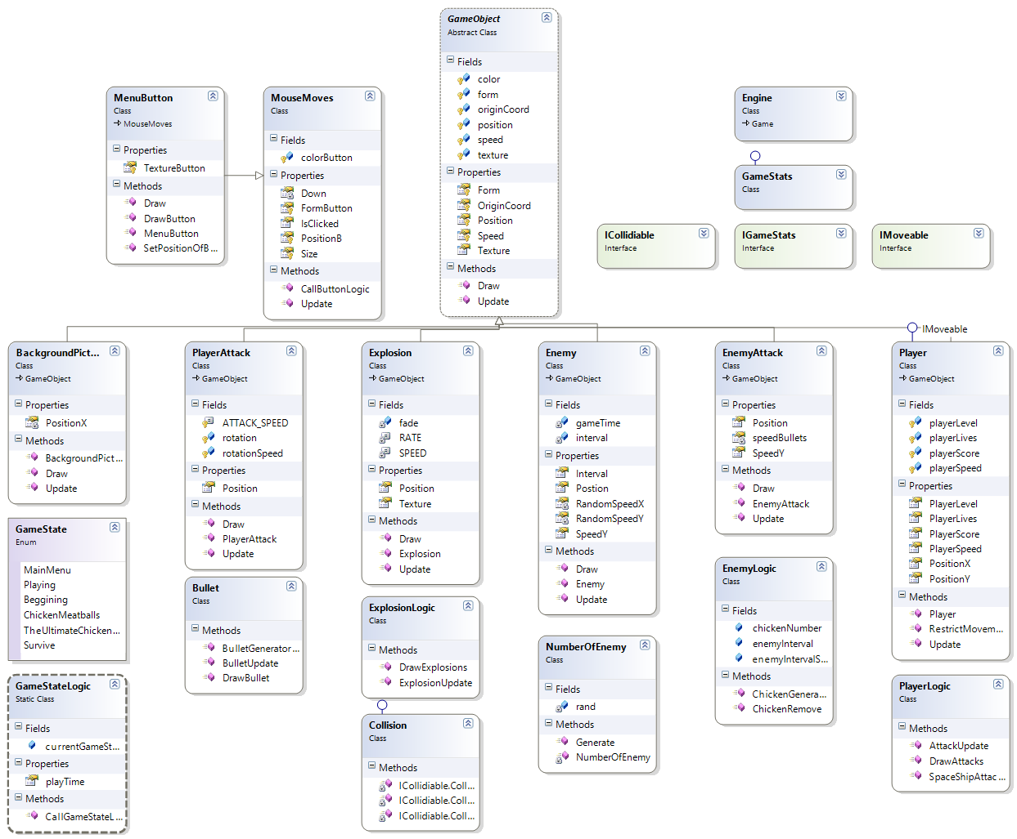
Class Diagram

Slide 4


Team Foundation Server
Dee Dee
http://deedee.codeplex.com/SourceControl/list/changesets

Slide 5


Questions?

